Slide 1
Splines: B-Spline Project
Team: Bryan Ellis, Adam Macgregor, Javed Sahadat

Slide 2
Introduction
Task: Implement a 3D B-Spline curve that represents a vessel within the brain.
Inputs:
a smooth path that represents the path of the desired vessel
diameter values for the smooth path data
MRI data to help create visualizations of the brain

Slide 3
Methods: B-Splines
Combination of Bezier curve defined by a set of control points
domains are also subdivided into points called knots
made of control points, knots and knot coefficients which have to satisfy the condition of continuity

Slide 4
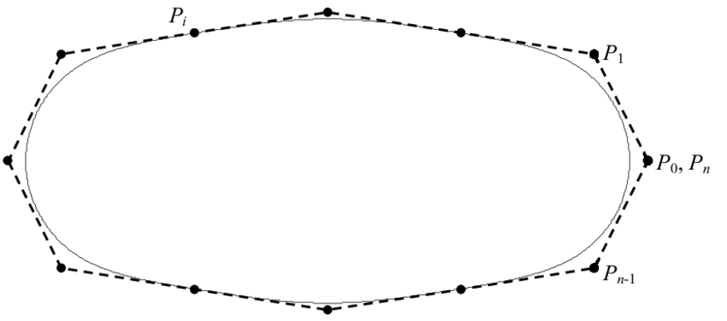
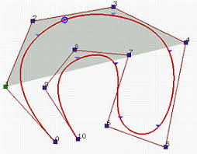
Methods: Open B-Splines
B-Splines can be either open or closed.
Open curves have the property where the first and last legs are not tangent to any knot or control point
Examples:

Slide 5
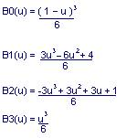
Methods: Spline Algorithm
Used weighted/basis functions for the control points
Certain requirements are met such as positional continuity, which means each segment’s end point is the starting for the new segment
The second constraint is tangential continuity which means there are no sudden changes in slope going from one segment to another.
Lastly curvature continuity no polarity changes from segment to segment.

Slide 6
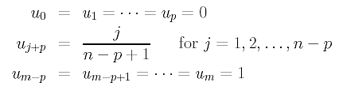
Methods: Knot Generation
Knots are padded with degree 0 to p at beginning
Knots are padded with degree m-p to m at the ending
The algorithm above will uniformly space all knots, u will be the knot number

Slide 7
Methods: Cox-De Boor's Algorithm
Identify a point in space for knot position
Determined by Spline degree
Recursively determined by knots and the previous levels of control points.
Spline of degree 3 require 4 control points and 6 knots

Slide 8
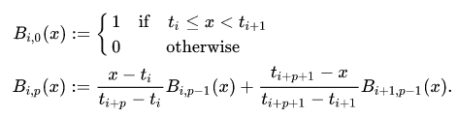

Methods: Cox-De Boor Formula
The spline curve S(x) is evaluated at a position x
The position x is and element of the knot interval t to t k+1
The final evaluation is done by multiplying the recursion Bip(x) by the control point ci, i is the interval

Slide 9
Implementation: Program
Inputs
Large MRI data file that represent 2D MRI images.
Smooth path data file that represents a smooth path of a vessel in the brain.
Diameter data file that represents the diameter at each point of the vessel.
Program steps:
Import data.
Find the control points using the smooth path data.
Calculate a B-Spline for using the control points.
Calculate the percentage error of our spline.
Receive user input to specify desired output.
Output:
3D graph of the vessel transposed against the 2D MRI image(s) that the user selects.

Slide 10
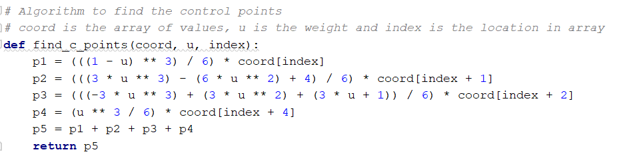
Implementation: Control points function:

Slide 11
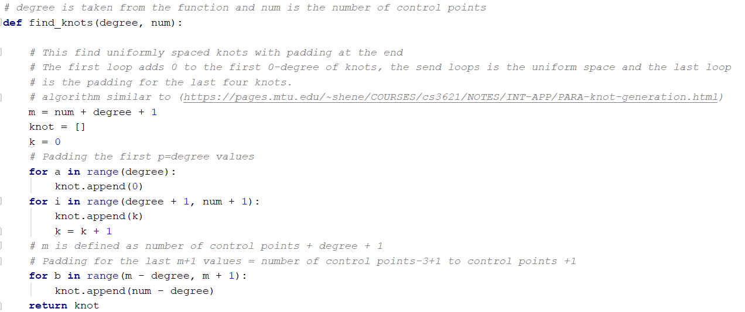
Implementation: Knot Function

Slide 12
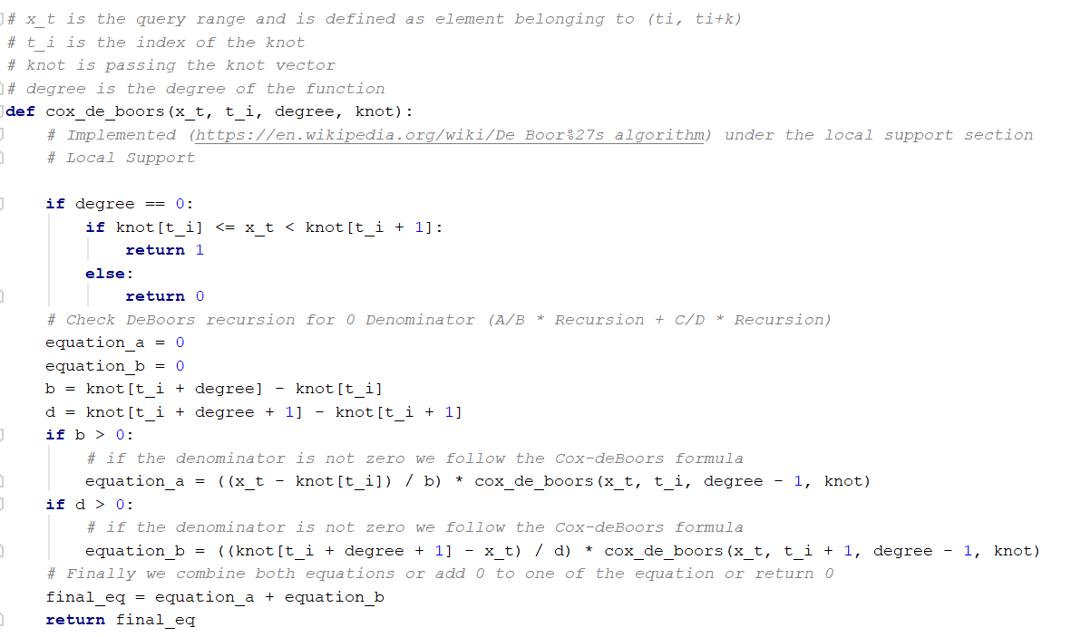
Implementation: Cox-De Boor’s Function

Slide 13
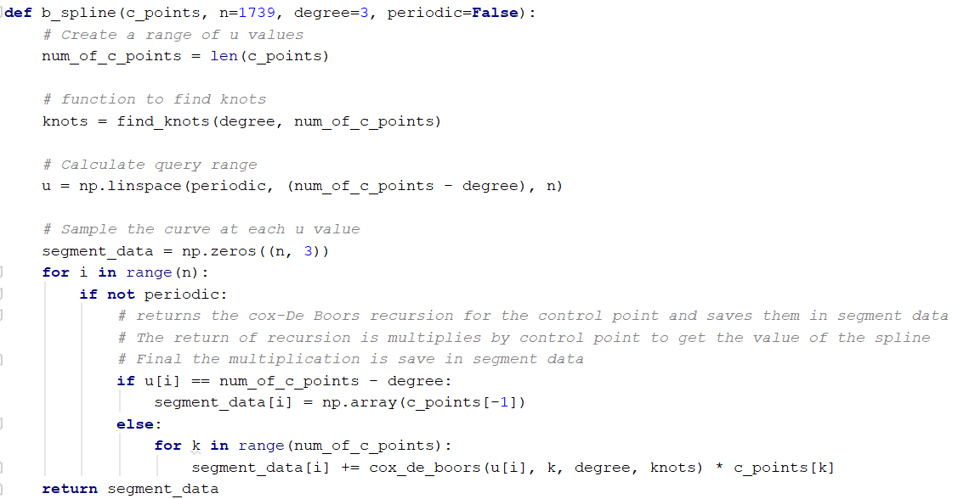
Implementation: Spline Function

Slide 14
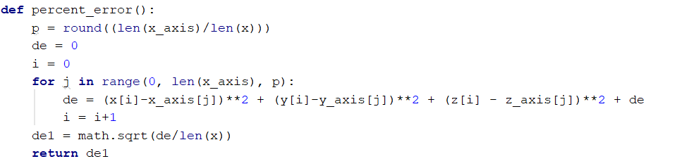
Implementation: Error Checking

Slide 15
Implementation: Plotting
Used the matplotlib library to plot a 3D render of our spline as a line only
Used the mayavi library to combine the diameter data and the spline data
Used both the mayavi and tvkt libraries to convert our image data into data that is usable with our 3D vessel plot.

Slide 16
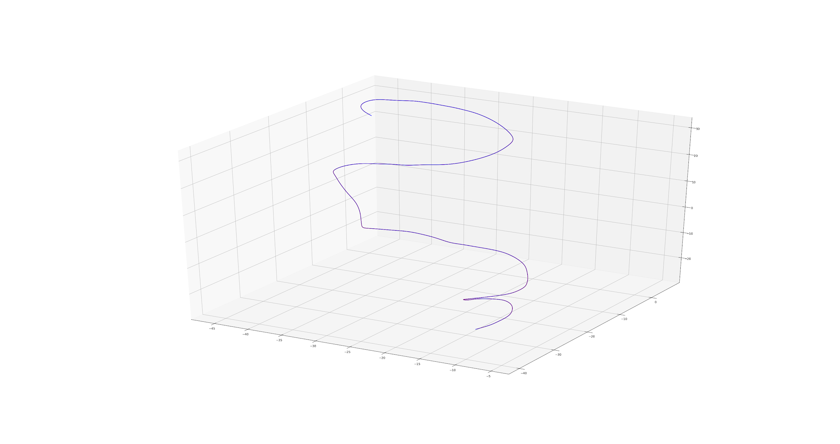
Results
Percentage Error: 0.16718807139561817
Spline Output:

Slide 17
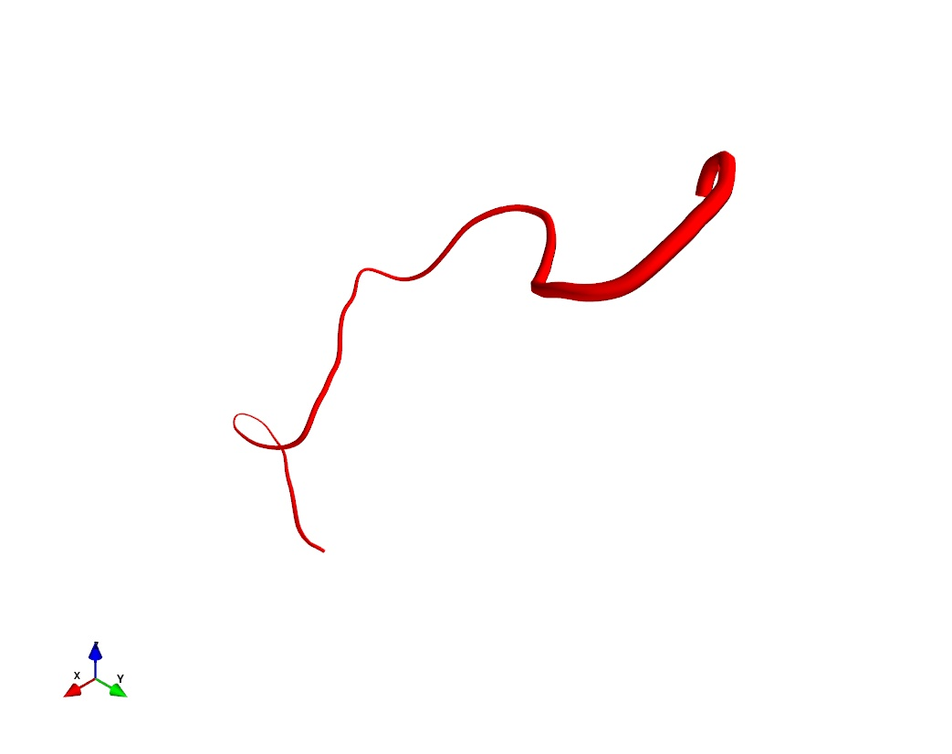
Results: Vessel

Slide 18
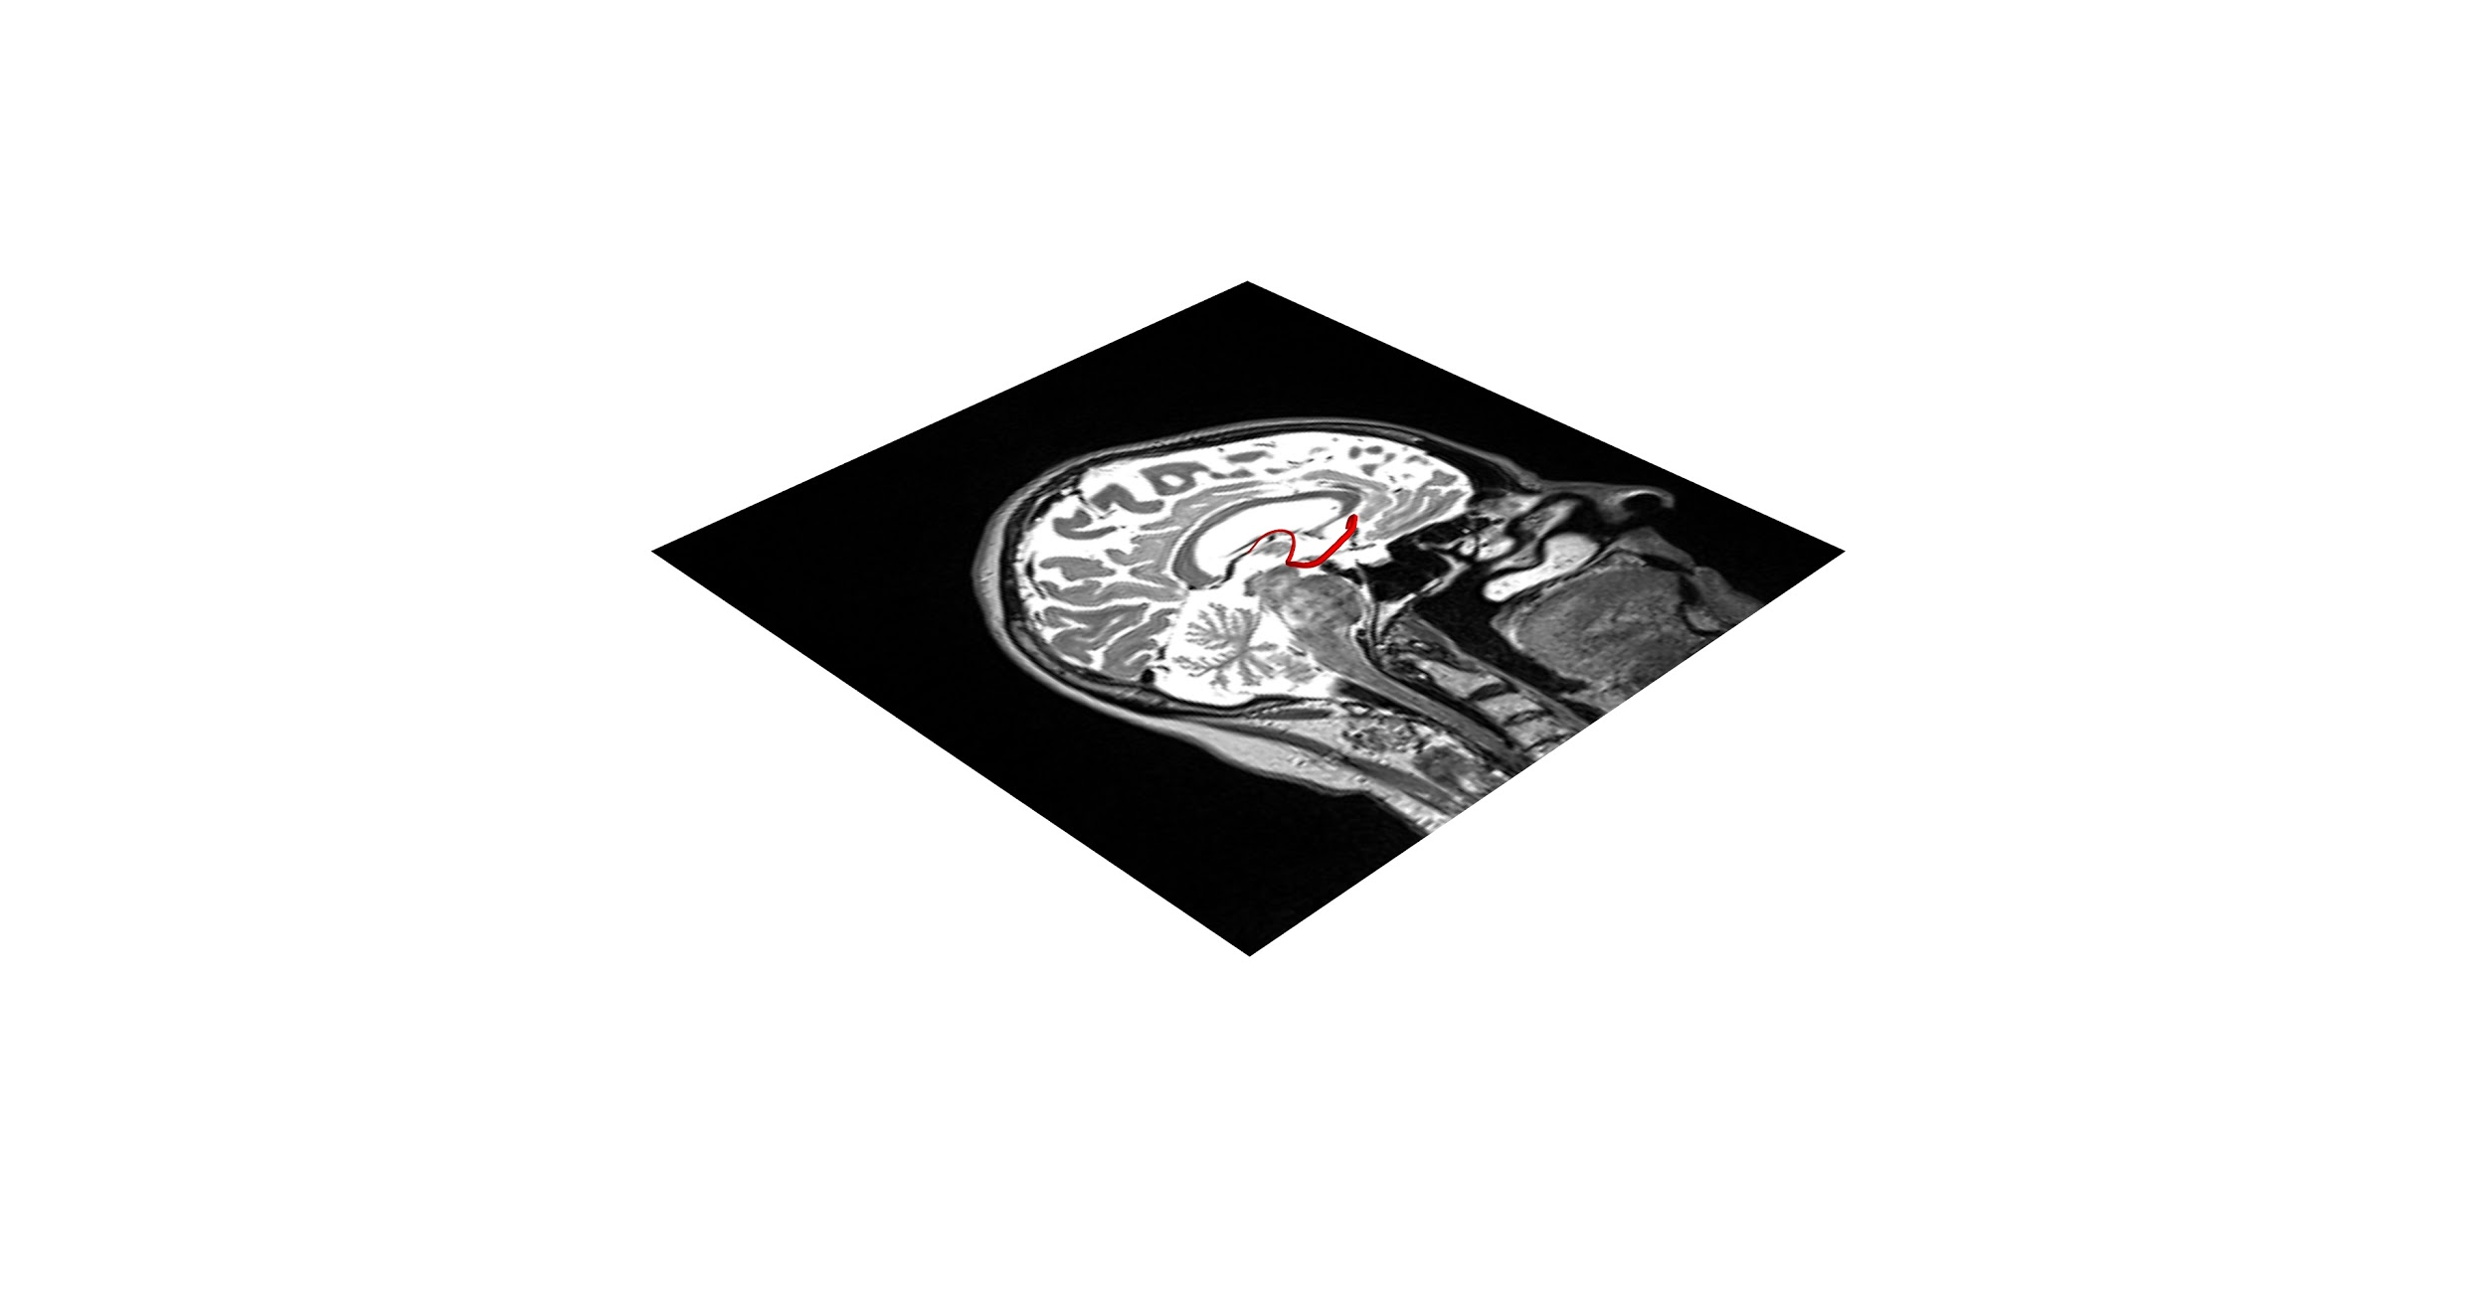
Results: Vessel alongside MRI Images
Single Image:

Slide 19

Results: Vessel alongside MRI Images
Multiple Images:

Slide 20
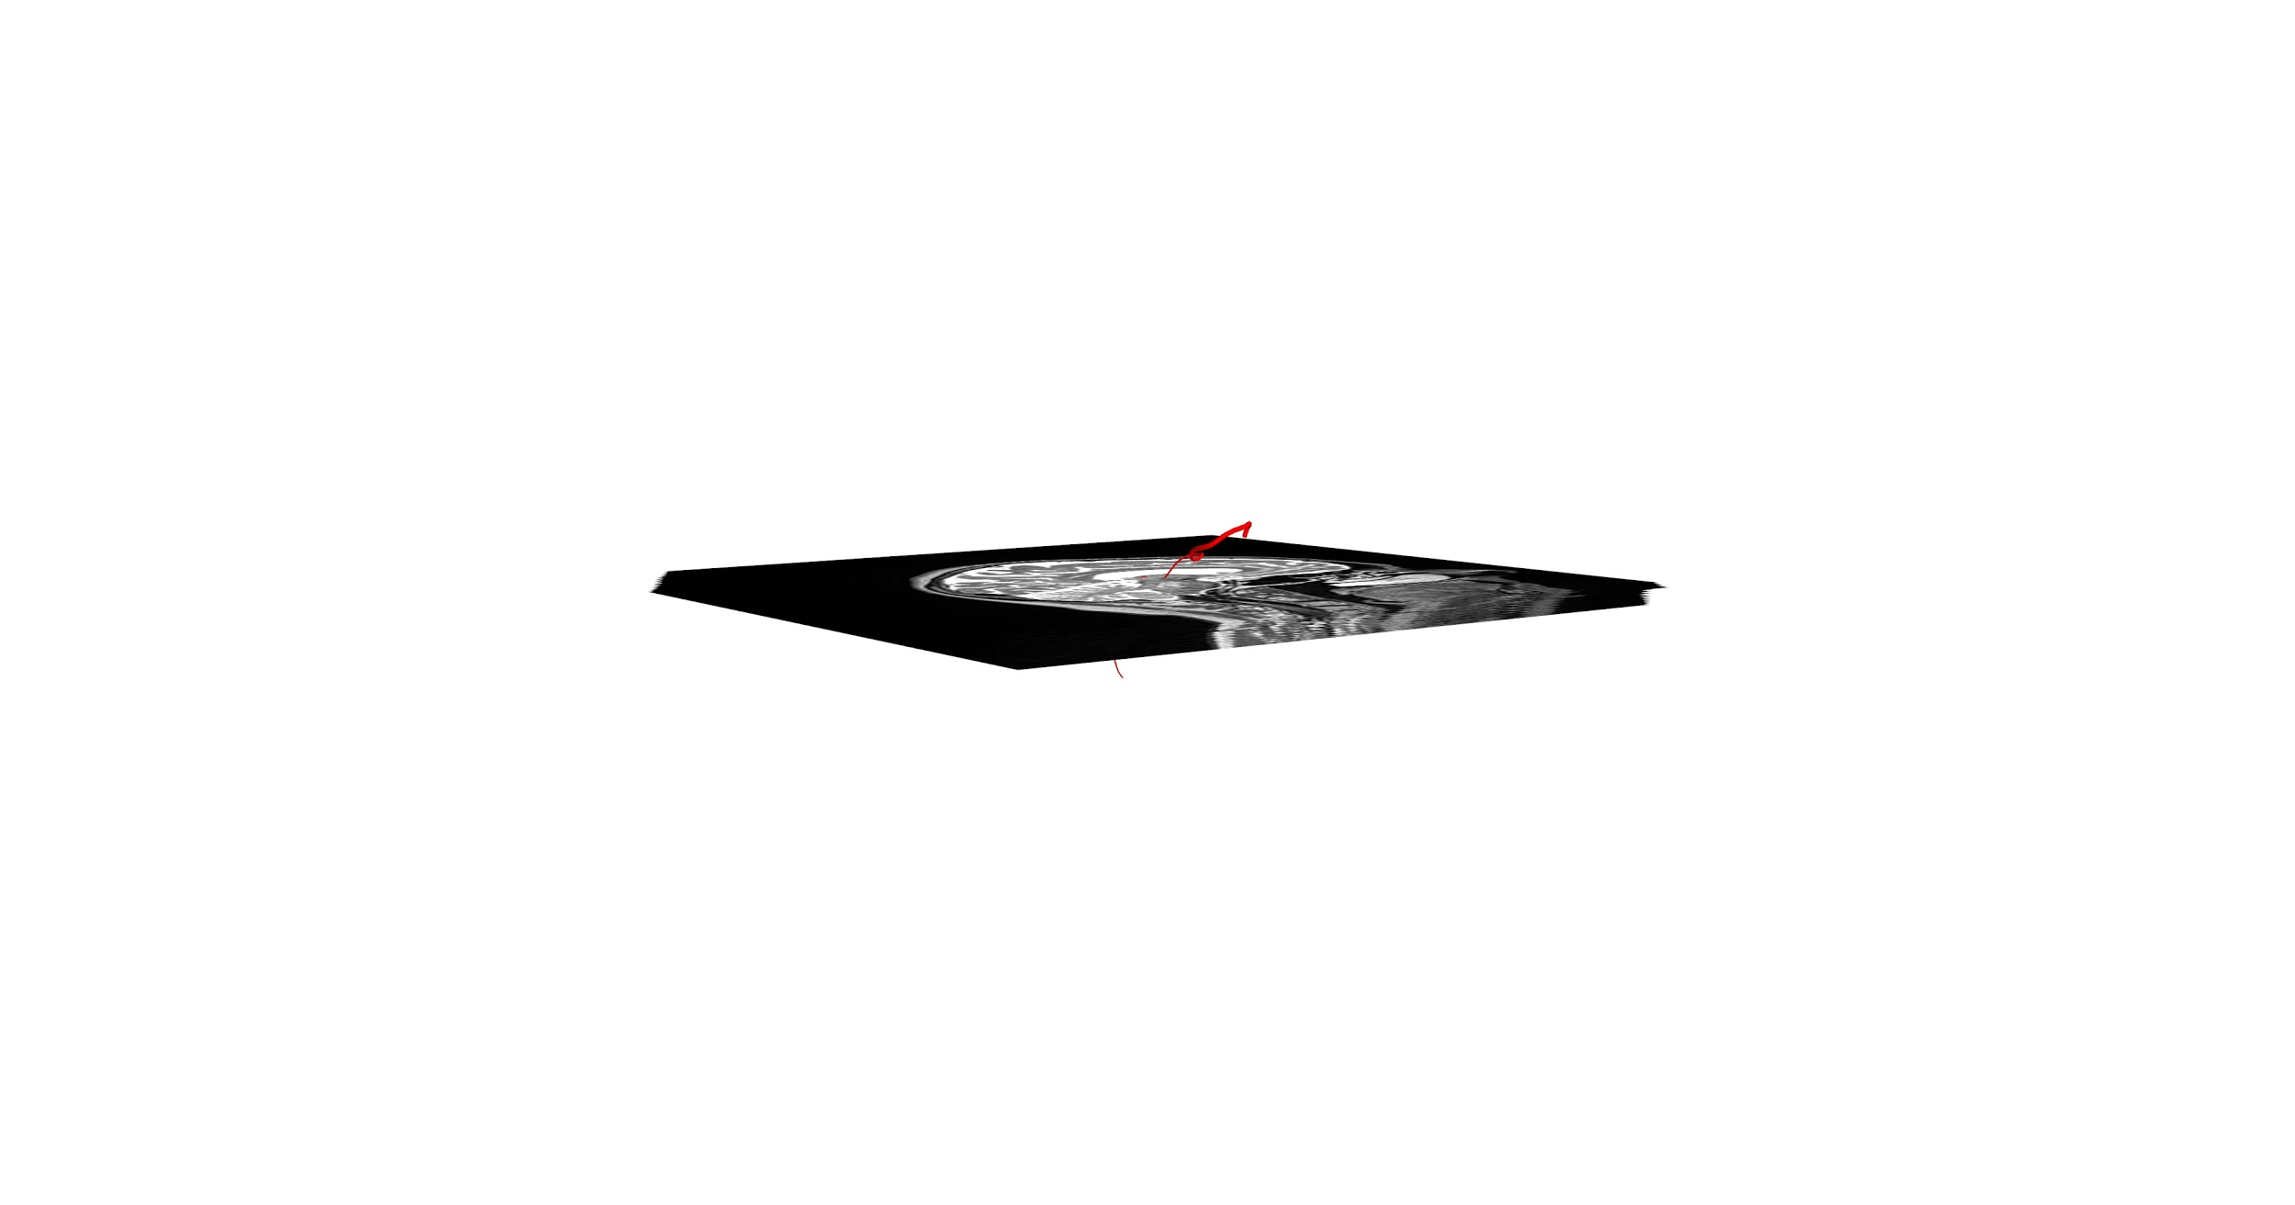
Results: Vessel alongside MRI Images
Image Range

Slide 21
Conclusion
Achievements:
Successful B-Spline
B-Spline and images represented together
Shortcomings:
Efficiency
No 3D render of the MRI data

Slide 22
References
https://en.wikipedia.org/wiki/De_Boor%27s_algorithm
https://pages.mtu.edu/~shene/COURSES/cs3621/NOTES/spline/B-spline/bspline-curve-prop.html
http://www.cs.utexas.edu/~bajaj/graphics2012/cs354/supp-lectures/Lec11-supp2.pdf

